Slide 1
Expanding Opportunities for Justice Involved Individuals – The Transformational Path

Slide 2
The Evolution of Corrections – some historical perspective to begin

Slide 3
Early forms of incarceration in Illinois
Public flogging, the pillory for imprisonment, or a short time in county jails comprised the earliest forms of punishment for public offenders after Illinois was chartered in 1818 as the nation's 21st state. The state's few jails consisted of the most part of rude log dwellings.
Hans W. Mattick and Ronald P. Sweet, authors of Illinois Jails, have described well the procedure for booking prisoners in the rustic structures: In those days, a typical prisoner would have entered a two-story log structure with three or four narrow, barred windows through the only door, located on the second floor. If he was considered dangerous, he would have been let down to the ground floor on a ladder placed through a hole in the ceiling and later withdrawn. He shared his quarters with the debtors, the insane, the inebriate and other "evil doers." Generally, no heat was provided and a bucket served his sanitary needs.

Slide 4
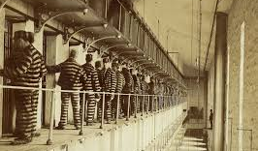
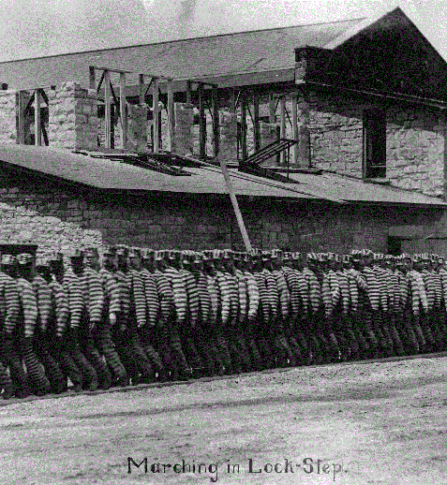
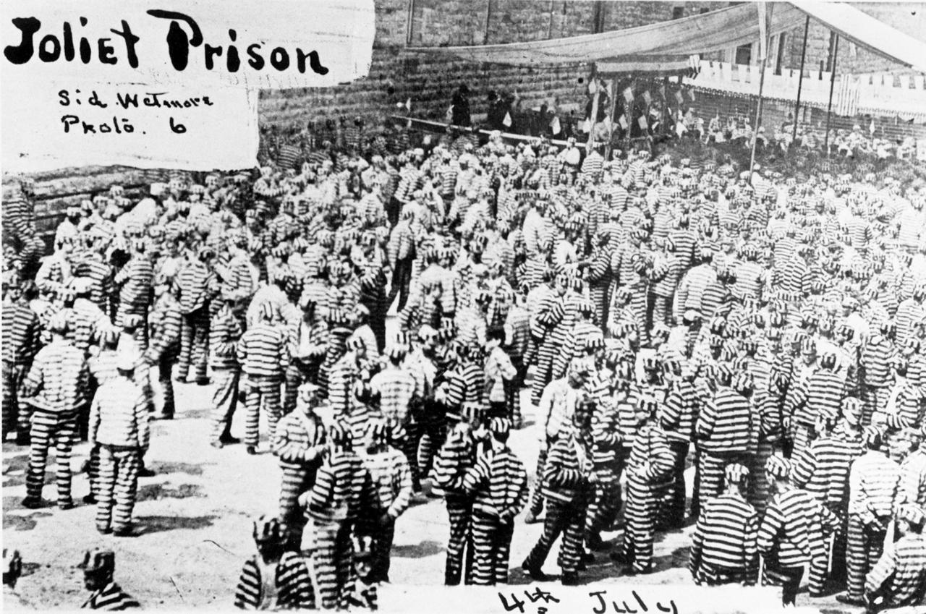

Slide 5
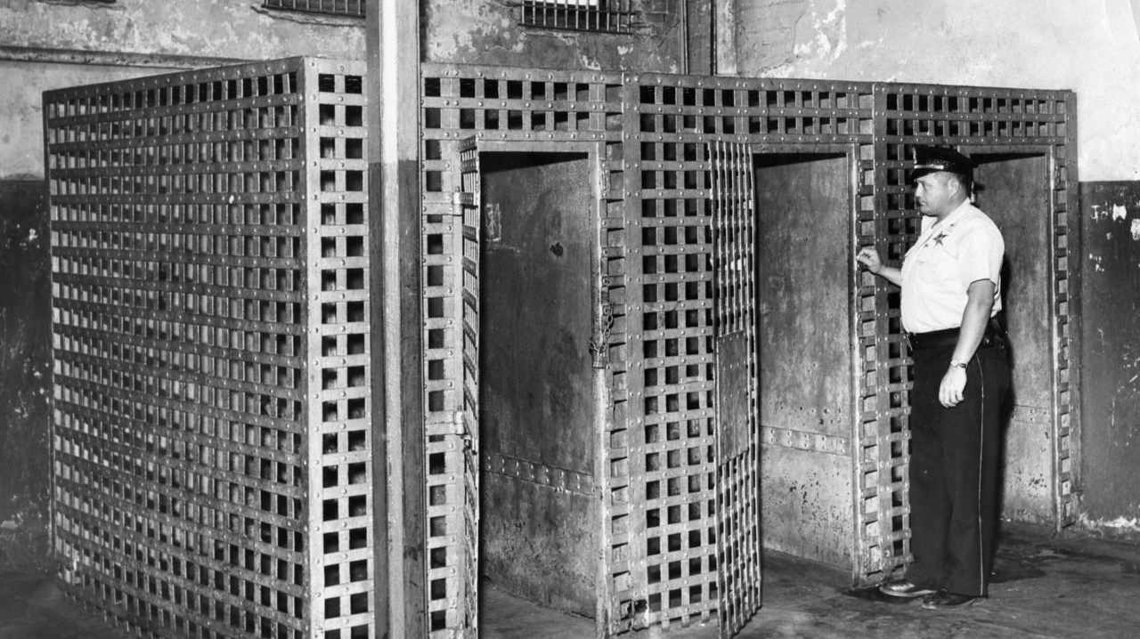

Slide 6
For the women…

Slide 7
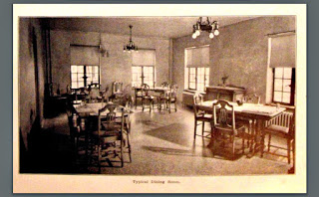
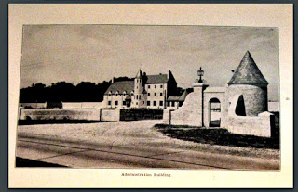
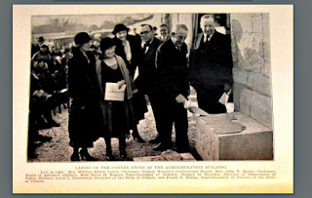
http://offthebeatenpathinillinois.blogspot.com/2016/10/oakdale-womens-reformatory.html
In the early 1930's Illinois prisons were dank, overcrowded, and sanitary conditions were fair at best. Dismal at worst. The Women's Clubs of Illinois undertook a project to build an institution strictly for incarcerated women and in 1931 at a cost of $850,000.00 a state of the art facility was built in the farmlands outside Dwight. The location was chosen for it's pleasant countryside, flora and fauna because it was believed that "Beautiful surroundings, orderly training and kindliness would overcome the effects of bad breeding, environment, and adverse mental conditions".

Slide 8
Here are a few lines from the dedication brochure that was given out on opening day: "Believing idleness is a contributing cause for the unrest and discontent so prevalent in institutions the policy that has been approved allows for 8 hours of work or school 6 days a week", "The commercial laundry offers an excellent opportunity for those adapted to this work-hand laundry being part of the training. The industrial building includes space for power sewing machines, with opportunity for hand sewing, mending, fancy work and the factory type of sewing. The garden of 12 acres, the care of the flowers and shrubs, 130 sheep and 2000 chickens and the farm work provide the outdoor work so beneficial to certain groups. Home economics and canning form part of the work"

Slide 9
A new era in corrections in Illinois was begun on July 22, 1969, when Governor Richard B. Ogilvie created the Task Force on Corrections, and named as its chairman Peter B. Bensinger, chairman of the Illinois Youth Commission. The task force met throughout the summer of 1969 and presented its recommendations to Governor Ogilvie that November.
In presenting his message outlining creation of the new Department of Corrections to the 76th General Assembly, Governor Ogilvie said, "In recommending this department, I emphasize this: we must break the present cycle of arrest, incarceration and release, which in a majority of cases is repeated over and over again. We are faced with the most difficult of all tasks–the understanding and changing of human behavior–and we must approach our job with a full awareness of the failure of past policies.
"In Illinois we keep our adult felons incarcerated for periods longer than 45 other states, yet our rate of recidivism, or return to prison, is one of the highest. We speak of rehabilitation, but we provide only one vocational officer to every 50 custodial officers at Joliet. We have given our state a half-way house program and work release programs, but we have not given a full professional department to administer these programs.“
"The proposal which I am submitting to you today for the creation of the Department of Corrections is an adaption of the Model Act for Standard Correctional Services of the National Council on Crime and Delinquency. This Model Act has served as the pattern for penal reform in four states in the last three years. It reflects a joint effort, which we have undertaken with the John Howard Association and the Illinois Committee of the NCCD."

Slide 10
The Times Are Changing

Slide 11
Agency Mission
To serve justice in Illinois and increase public safety by promoting positive change for those in custody, operating successful reentry programs, and reducing victimization.

Slide 12
Programs and Support Services’ Mission
The mission of the Division of Programs and Support Services is to provide a continuum of service for those committed to the Department of Corrections from the point of incarceration to discharge from parole by providing a system for the delivery of consistent and effective programs that meet the needs of the committed offender and that enhance their ability to become a productive member of society upon release.

Slide 13
How do we accomplish both of those missions?

Slide 14
Risk and Needs Assessment – the Driver of Program Delivery

Slide 15
Implementation of the ORAS

Slide 16
Programming and Education are key to ending cycles of poverty and crime
How are we furthering our programming with the men and women in custody?

Slide 17
PROGRAMMING!!!!!!!!!!

Slide 18
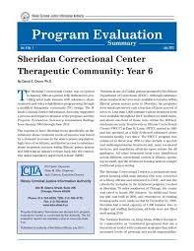
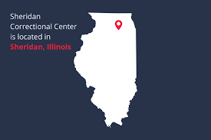
Sheridan Correctional Center

Slide 19
Sheridan Correctional Center
The Sheridan Correctional Center is one of the largest substance abuse treatment programs in the nation. The facility was reopened on Jan. 2, 2004, to curb the trend in Illinois' growing prison population to reduce high recidivism rates of released Illinois individuals in custody , providing men with evidenced based substance abuse treatment services, and using the Therapeutic Community approach to equip individuals in custody to return to drug-free, crime-free lives upon release.
Treatment interventions and access to other services are coordinated from the outset. The substance abuse provider collaborates with a cadre of service providers, the Illinois Department of Corrections and Adult Parole to effect community reintegration of returning individuals in custody and improve public safety.
Sheridan Correctional Center applies clinical best practices and uses a modified therapeutic community model with cognitive self-change. Sheridan Correctional Center staff collaborates with other organizations to clinical reentry management services and community reintegration, including continuing care provided by community-based substance abuse treatment providers.

Slide 20
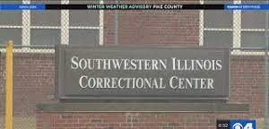
Southwestern Correctional Center

Slide 21
Southwestern Illinois Correctional Center
Southwestern Illinois Correctional Center in East St. Louis was established as a first-of-its-kind national model for reducing crime and recidivism among Meth offenders. The facility and reentry program focused on specific challenges facing people addicted to Meth so they can lead productive crime-and drug-free lives once they return to their families and communities. The program is now open to individuals who have other substance use disorders as well.

Slide 22
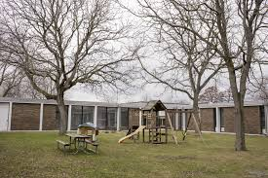
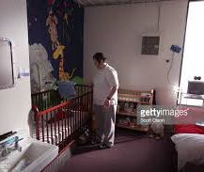
Decatur Correctional Center – Moms/Babies and Family Reunification Units

Slide 23
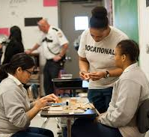
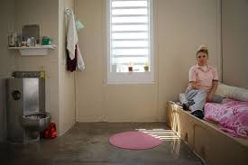
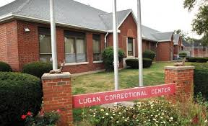
Logan Correctional Center – utlizing gender responsive treatment and care

Slide 26
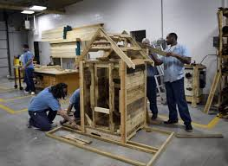
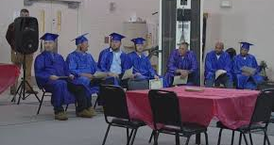
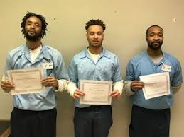

Slide 27
Educational and Vocational Programming
Evaluate current educational/ vocational programming
Review existing curriculum in Adult Basic Education programs
Align current vocational programs with industry trends
Begin to incorporate industry recognized credential into existing identified vocational programs

Slide 28
Educational Programming
Adult Basic Education – An open-entry program designed to provide individual instruction in basic math, reading and life skills to those who test below a 6.0 on the TABE test.
Pre-GED – An open-entry program designed to improve individuals’ basic math, reading and life skills to improve TABE test results from 6.0 to 9.0 for entry into GED program.
General Education Development (GED) – An open entry-program which will prepare an individual for the GED test as well as life skills. Program entry is based upon a TABE score of 9.0 or above.

Slide 29
Vocational Programming
Auto Body
Auto Technology
Construction Occupations
Cosmetology
Culinary Arts
Custodial Maintenance
Horticulture
Industrial Maintenance
Restaurant Management
Warehousing
Welding
Career Technology
Culinary Bridge Program
Notes:
Custodial Maintenance – offers practical hand-on experience in floor care, cleaning and general light maintenance. (Both college and Office of Adult Education Program)
Construction Occupations – provides instruction and hands-on experience in trades associated with construction and building maintenance. (Both college and Office of Adult Education Program. At Sheridan this is offered by Home Builders)
Horticulture – programming designed to give the student skills in landscaping, greenhouse operations and turf management.
Auto Body – instructional program teaching the skills necessary for entry level employment in auto body.
Auto Mechanics/Automotive Technology – provides instruction and hands on training in auto mechanics skills in repair of systems such as fuel, brakes, exhaust, ignition and cooling.
Cosmetology – instructional program leading to state certification as a licensed cosmetologist.
Barbering - instructional program teaching the skills and techniques of barbering.
Welding - Welding prepares offenders for positions of employment as welders in shielded metal as well as stick welding, gas metal arc welding (MIG), gas tungsten arc welding (TIG), flux cored arc (F caw) welding, and oxyacetylene cutting and welding. Comprehensive training in flat, overhead and horizontal welding positions is provided. Hands-on instruction is emphasized with additional theory presented in textbook and workbook format.
Warehousing (Shipping/Receiving) - Offenders learn all functions of warehouse operations, including shipping, receiving, forklift operations, and data entry. Skills include OSHA regulations, record keeping, communication, and upkeep.

Slide 30
College Programming
College programming is offered at various institutions.
College degree programs allow the student to obtain an Associate’s by earning 60 college credits through acceptable performance in college classes offered by Community Colleges under contract with the Department at each facility.
Various universities are now offering advanced degrees for the population.

Slide 31
Reentry Unit – Enhancing Reentry Pathways

Slide 32
Reentry Resource Rooms
Vital Documents
Medicaid and benefits applications.
Employment soft skill attainment
Service planning

Slide 33
Workforce Development
Enhance
Enhance workforce development and partnerships with businesses around the state to improve employment options and placement.
Cultivate
Cultivate and enhance relationships. Continue to meet with the local workforce areas and IDES regional personnel where IDOC prisons are located and develop a process for their staff to work with offenders around employment.
Increase
Increase vocational training with WOIA funds where available in labor demand fields.
Develop
Develop regional job fairs and then facility specific job fairs in specific employment fields. The goal of each job fair is to place at least 10% (to start) of the offenders that participated in a job prior to release.
Assemble
Assemble informational packets together about IDOC vocational training programs and ICI training and employment. Continue to work with DCEO for support with grant funds and statewide initiatives.

Slide 34
Housing
Increase
Increase housing options for individuals leaving IDOC.
Enhance
Enhance monitoring of placement contracts to ensure they are in compliance and meeting the requirements of IDOC.
Continue
Continue to work with IDPH around housing pilot that will provide housing for 100 individuals over 3 years.
Collaborate
Collaborate with community stakeholders such as the regional housing task force. Work to remove possible barriers to housing especially with special populations.
Realign
Realign PRG and CAS staff, resources, and responsibilities where needed.
Assess
Assess service provision and develop a more robust way to provide resources that will aid the parole agents and parolees around housing and treatment.

Slide 35
Coordination of Care

Slide 36
Questions

